Slide 1

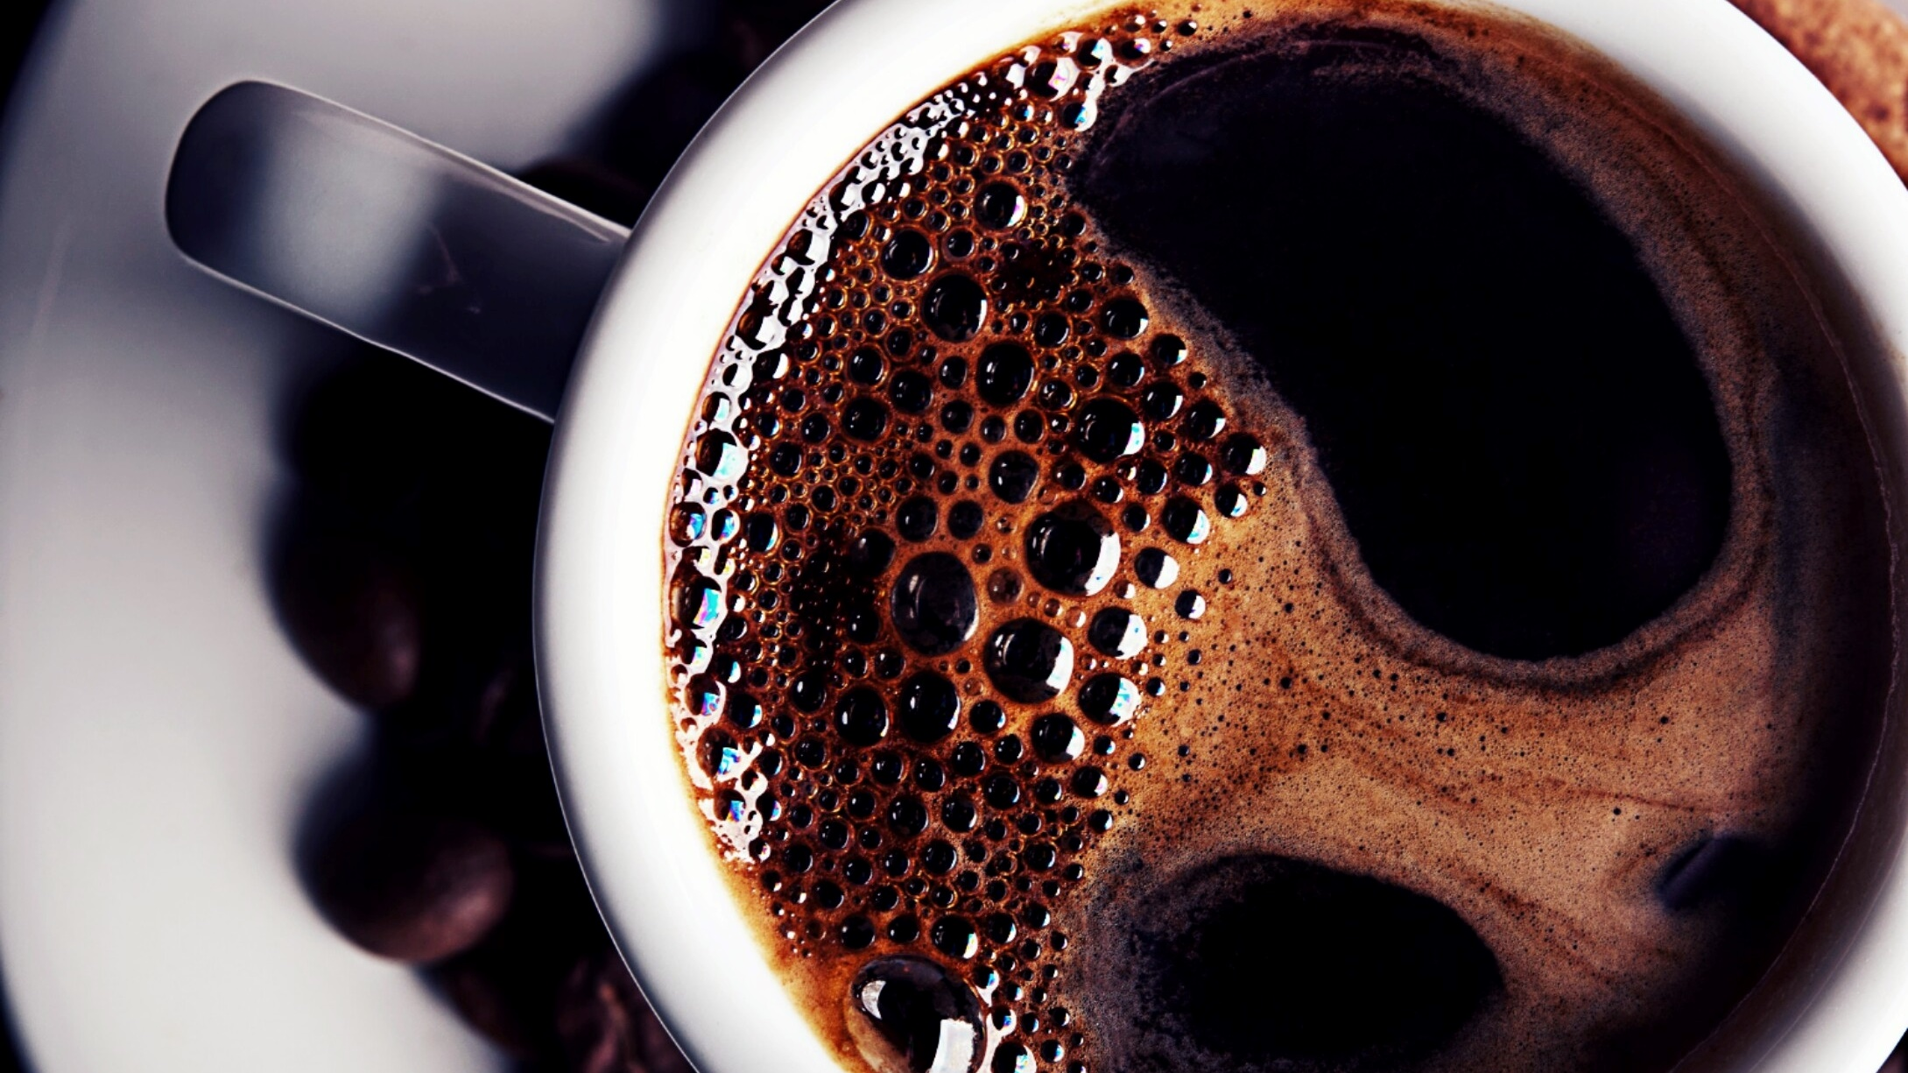
Panthu’Da Dhaba
MADE BY : PANTHAK M YADAV
ENROLLMENT NO : 24C11093
FROM SECTION : C

Slide 2
Overview of Project.
Panthu’da dhaba is a take away restaurant, where people can buy their most liken food item whenever they want.
This project is made from scripting languages like java script, css and html . I have used very basic color combinations so that my website looks good.
Website have functions like place order , how many quantity you want , which type of cuisines you want , also have greeting and bill functions.
I have also used linker so that you can directly go to that cuisine by just clicking it and it also have footer for the better output.

Slide 3
Who will get benefits from website?
PEOPLE WILL GET BENEFITS OF VARIOUS TYPES OF CUISINES . WHICH MEANS THAT THEY WILL HAVE VARIETY OF FOODS TO ORDER AND EAT.
OUR ALL THE FOOD ITEMS ARE VERY CHEAP FOR ORDERING IT .
THEY CAN TAKE AWAY THE ORDER FROM THE RESTAURENT FOR HAVING THEIR FOOD WHEREVER THEY WANT.
WE WILL ALSO START FOOD DELIVERY TO HOMES SO THAT PEOPLE CAN PLACE A ORDER FROM OUR WEBSITE AND FOOD WILL REACH THIER HOME WITHOUT ANY TENSION.

Slide 4
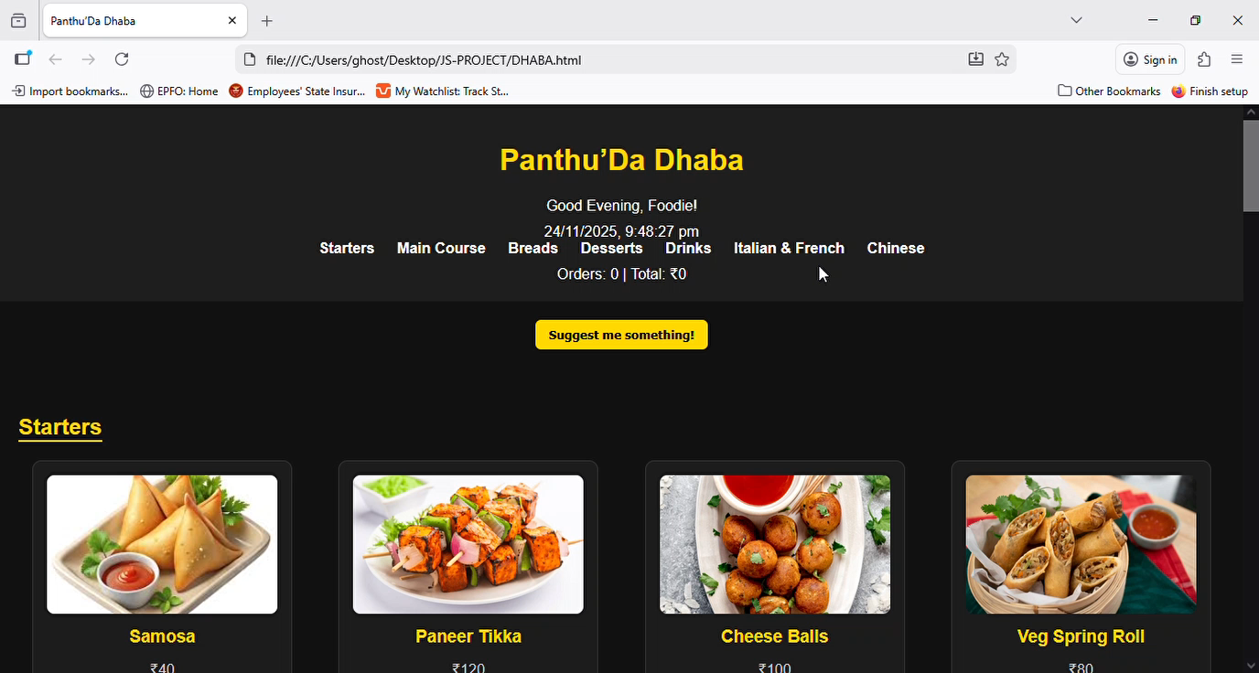
VIDEO OF WORKING WEBSITE.

Slide 5
THANK YOU …..

